Slide 1
Defining New Types

Slide 2
Defining New Types
struct vs. class
Difference:
default access for struct is public
default access for class is private
a C-compatibility thing
affects inheritance too!
Different than C#!!!
Unless you pointers or references inside a struct/class, all instances are value types
Using new is not required when creating objects

Slide 3
A “Pair” Structure
template<typename T, typename U>
struct Pair {
T first;
U second;
Pair(const T& t, const U& u) : first(t), second(u) {}
};
int main() {
Pair<string,int> p{"one",1};
cout << p.first << ',' << p.second << endl; // one,1
}

Slide 4
Initializing Static Data Members
For non-const static members, only the declaration goes in the class definition
Usually in a .h file
The definition of the member must occur at global (i.e., file) scope
Usually in a .cpp file
Defines space for the member in the data segment
(There is no “class object” in C++ like in other OO languages)
Don’t forget this!!!
Notes:
Very different from other languages.

Slide 5
Defining a Static Pool Object From Program 1
In MyObject.h: class MyObject { static Pool pool; … };
In MyObject.cpp: Pool MyObject::pool(…);

Slide 6
Read-Only Member Functions
Every non-static member function receives a hidden, first parameter named this
The type of this for C::f(int n):
void C::f(C* const this, int n){…}
a const pointer
not a pointer-to-const
Accessing a member x in f is identical to this->x
To guarantee a method doesn’t change data, we want:
void C::f(const C* const this, …) {…}
How to declare it?

Slide 7

const Member Functions
The this parameter is not visible
so we can’t adorn it
Solution: add const after the parameter list in the declaration and definition (if they’re separate):
void f(…) const; // Inside class C
void C::f(…) const {…} // Outside
Declare all member functions that don’t change data as const

Slide 8
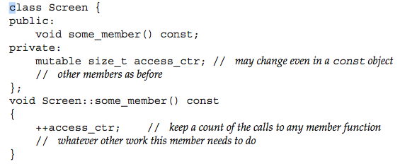
“Exceptions” to const Member Functions
You can declare some data members to be mutable
Even const member functions can change them
Useful for implementation detail that doesn’t affect users
e.g., cache information
Notes:
const is a “user-view” thing. See also: mutable.cpp.

Slide 9
inline Member Functions
Work just like inline regular functions
put body in header file
a hint to the compiler
Additional case for member functions:
when you define the body of a member function inside the class definition, it is implicitly inline

Slide 10
Related Non-Member Functions
Not all functions related to an abstraction can (or should) be member functions
stream operators can’t be member functions
the first argument is the stream, not the object
most binary operators should not be member functions
for symmetric implicit conversions (discussed later)
They are still part of the abstraction
declare them in the header file along with the class definition
This is known in C++ as the Interface Principle

Slide 11
Friends
Since non-member functions may be part of an abstraction, they are entitled to access to non-public data
Such functions are called friends
getters are not always required! (and rarely recommended)
Declare friends inside the class granting access
if not currently in scope, the compiler will look for friends in the scope containing the class
unless they are defined with bodies directly inside the host class(!)
Declaring a class a friend allows all of its member functions access to the host class’s members { … friend class Foo;
Notes:
You shouldn’t always have getters or setters anyway!

Slide 12
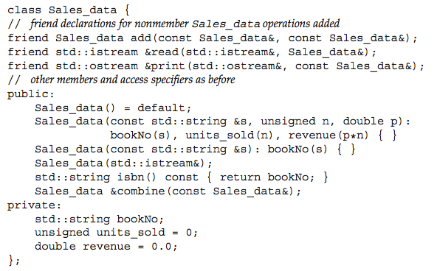

Notes:
A sample header file with friends.

Slide 13
In-Class Initializers
Like Java and C#, you can specify initializers for data members in the class definition
new in C++11
always execute
before any constructor does
good practice for built-in types
Static data members must be const to use in-class initialization
struct Foo {
int x{0};
const static int y{1}; // No other init. needed
};
Notes:
No need to define space externally for const static data members.

Slide 14
Constructors
Execute after an object’s memory is allocated
Used to initialize an object’s memory
Which constructor executes depends on arguments passed
Execute after sub-objects are initialized
Base classes and sub-objects initialize first
Example: initMembers.cpp

Slide 15
Initializing Member Objects Default Behavior
Member objects are default-initialized
in declaration order
class types run the default constructor
built-in types are not initialized by default
you should use in-class initializers, initializer lists, or a constructor
See initInt.cpp, defaultinit.cpp
“Zero Initialization”:
Occurs with an explicit call to a default ctor
Even with built-ins: int x = int( ); // 0
See defaultinit2.cpp

Slide 16

Constructor Initializer Lists
For passing parameters to constructors of embedded data objects (and base classes)
Very important!
if not used, the data member will automatically be default-initialized before the constructor for the complete object is called
it will be “initialized” twice if you do it with an assignment in the complete object’s constructor
never initialize a member object by assignment in the body of the constructor!
See badInit.cpp, goodInit.cpp, constMem.cpp

Slide 17
Enumerations
A good way to define named constants
Makes code more readable and maintainable
Use the enum keyword
Two styles:
Plain enumerations
Typed enumerations

Slide 18
Plain Enumerations
Inherited from C
Values are integers
Implicitly starting at 0
Residing in the current, enclosing scope
Can be freely inter-mixed with integral expressions
Not always a good thing!
enum {x, y=3, z}; cout << x << y << z; // 034

Slide 19
Typed Enumerations
Defined with enum class <type name> {…}
Define a new, distinct type
The new type is its own scope
Must qualify with the type name (e.g., Color::red)
Doesn’t clash with other names in the enclosing scope
Are not allowed in integer expressions
Can only be compared, assigned
See enum.cpp

Slide 20
Unions
Like a struct, but overlays all member at the same address
So only enough space for the largest member is used
Allows defining new types that can take on values of different, specified types
Intended mainly for built-in types
The bits are interpreted as the requested type
Be careful!
C++ allows you to reinterpret the bits as any of the types
Useful, but know what you’re doing!
See union.cpp, union2.cpp
Notes:
It’s difficult to use unions that contain user-defined types.

Slide 21
Command-line Arguments
Arguments to main
Passed as a pair:
int main(int argc, char* argv[]) {…}
The first argument is the name of the executable
Can’t use range-based for to traverse argv
why?
Notes:
Because its dimension is not in scope.

Slide 22
Getting Command-line Arguments
Charless-MacBook-Pro:3370 chuck$ c++ -o args args.cpp
Charless-MacBook-Pro:3370 chuck$ ./args one 2 three
./args one 2 three
Charless-MacBook-Pro:3370 chuck$ cat args.cpp
#include <iostream>
using namespace std;
int main(int argc, char* argv[]) {
for (int i = 0; i < argc; ++i)
cout << argv[i] << ' ';
cout << endl;
}

Slide 23
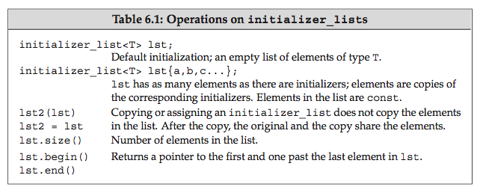
Variable-length Argument Lists
If all are of same type:
use Initializer Lists
If different types:
use variadic templates (Chapter 5)
Both new in C++11
Notes:
Containers have constructors that take initializer lists.

Slide 24
void args(initializer_list<int> stuff) {
for (auto arg: stuff)
cout << arg << ' ';
cout << endl;
}
void args2(vector<int> stuff) {
for (auto arg: stuff)
cout << arg << ' ';
cout << endl;
}
void args3(list<int> stuff) {
for (auto arg: stuff)
cout << arg << ' ';
cout << endl;
}
int main() {
args({1,2,3});
args2({4,5,6,7});
args3({8,9,10});
}

Slide 25
Type Aliases with using
New in C++11
Giving existing types another name (like typedef does)
Handy for complex types
More readable than typedef
int main() {
using intseq = int[5];
intseq a;
for (int i = 0; i < 5; ++i)
a[i] = 5-i;
for (int i = 0; i < 5; ++i)
cout << a[i] << ' '; // 5 4 3 2 1
cout << endl;
}
Notes:
typedef is still allowed.

Slide 26
Type Aliases and Pointers
Adding const to an aliased pointer qualifies the pointer, not the pointee
int main() {
using pstring = char*;
// cstr is a const pointer to char
const pstring cstr = nullptr;
// ps is a pointer to a const pointer to char
const pstring *ps;
}
Neither of the above points to a const char*

Slide 27
The decltype Specifier
New in C++11
Used to infer a type from an expression
The compiler figures out the required type, but does not evaluate the expression!
Handy in templates
decltype (F()) sum; // “I’ll have what F returns”

